Slide 1
Unit Process Selection

Slide 2
Generalize the design process
Water Source
Possible Unit Processes
Contaminants
Select Unit Processes
Disinfection Complications
Regulations
Sequence the unit processes
Client needs
Distribution Complications

Slide 3
Unit Processes Defined
Unit process? “one or more grouped operations in a manufacturing system that can be defined and separated from others” https://en.wikipedia.org/wiki/Unit_process
Is flocculation a unit process?
Some unit processes only make sense as part of a sequence

Slide 4
Unit Process Cheat Sheet
Required upstream UP
Required downstream UP
Contaminants that must be removed prior to UP to protect the UP from damage
How does it work?
What types of contaminants does it remove
What types of inputs (energy and chemicals) does it requires
What might a cheat sheet look like? Is it a table? Or a flow chart with different entry points

Slide 5
Organize by choice (parallel) and order (series)
Adsorptive Media
Aeration and Air Stripping
Biological Filtration
Biological Treatment
Chemical Treatment
Chloramine
Chlorine
Chlorine Dioxide
Conventional Treatment
Diatomaceous Earth Filtration
Direct Filtration
GAC Isotherm (includes PAC isotherms)
Granular Activated Carbon
Hydrogen Peroxide
Ion Exchange Greensand Filtration
Membrane Filtration Microfiltration and Ultrafiltration
Membrane Separation Nanofiltration, Reverse Osmosis, Electrodialysis, and Electrodialysis Reversal
Other Treatment
Ozone
Ozone + Hydrogen Peroxide
Permanganate
Powdered Activated Carbon
Precipitative Softening
Pressure Filtration Bag Filtration and Cartridge Filtration
Slow Sand Filtration
Ultraviolet Irradiation
Ultraviolet Irradiation + Hydrogen Peroxide
Ultraviolet Irradiation + Ozone
Notes:
https://iaspub.epa.gov/tdb/pages/treatment/findTreatment.do

Slide 6
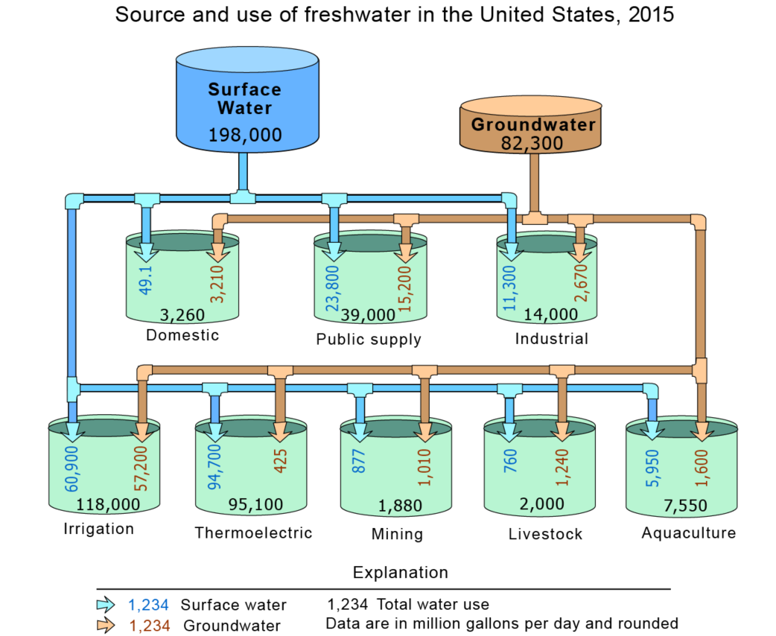
Water sources
https://www.usgs.gov/special-topic/water-science-school/science/groundwater-use-united-states?qt-science_center_objects=0#qt-science_center_objects

Slide 7
Generalize the design process
Water Source
Possible Unit Processes
Contaminants
Select Unit Processes
Disinfection Complications
Regulations
Sequence the unit processes
Client needs
Distribution Complications

Slide 8
Unit Processes
Rapid sand
Trash rack
Flocculation
Sedimentation
Slow sand
Membrane
Activated Carbon
Ion Exchange
Reverse Osmosis
Reverse Osmosis
Notes:
a. Screening, Coagulation, Flocculation (Chapter 9)
b. Sedimentation (Chapter 10)
c. Granular Filtration (chapter 11)
d. Membrane Filtration (Chapter 12)
e. Disinfection (Chapter 13)
3. Advanced Treatment Technologies (focus on dissolved species and chemicals)
a. Granular Activated Carbon (Chapter 15)
b. Ion Exchange Resins (Chapter 16)
c. High Pressure Membranes (Chapter 17)
d. Advanced Oxidation Process (Chapter 18)
4. Water Treatment Process Design Procedure (Chapter 23)

Slide 9
For each unit process
Concept: how does it work?
Types of contaminants that can be treated
Range of approach velocities
Range of hydraulic residence times
Energy required (J/L)
Inputs required or method of regeneration
Type of waste stream produced and disposal requirements

Slide 10
How do consulting firms, construction firms, venders, municipalities (clients) create a project?
We will hear about this process from Tori Klug and Michael Adelman (Engineers at Stantec) later in the semester.

Slide 11
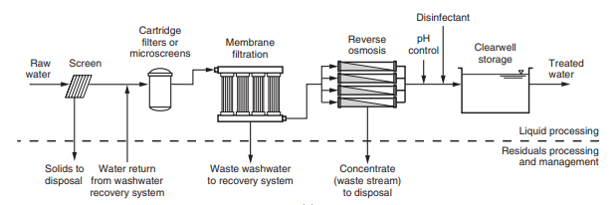
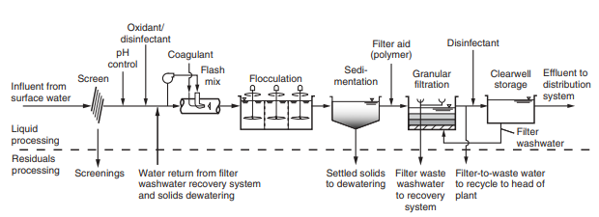
MWH's%20Water%20Treatment.pdf
Must create my own!

